Slide 1
Indexing
Extract specific information from data and access data through it
attributes, attribute vectors
Two step retrieval:
  hypothesis: search through the index returns all qualifying documents plus some false alarms
  verification: the answer is examined to eliminate false alarms
E.G.M. Petrakis
Indexing

Slide 2
Database Indexing Methods
Indexing based on
  primary key: single attribute, no duplicates
  secondary keys: one or more attributes
    duplicates are allowed
    indexing in M-dimensional feature spaces
Data and queries are vectors
  retrieval: two step search approach
E.G.M. Petrakis
Indexing

Slide 3
Primary Key Indexing
Dynamic indexing: the file grows or shrinks to adapt to the volume of data
  good space utilization and good performance
Methods:
  B-trees and variants (B+-trees, B*-trees)
  Hashing and variants (linear hashing, spiral etc.)
  hashing is faster, B-trees preserve order of keys
B-trees, hashing are the industry work-horses
E.G.M. Petrakis
Indexing

Slide 4
Secondary Key Indexing
Much interest in multimedia
  signals are represented by feature vectors
  feature extraction computes feature vectors from signals
The index organizes the feature space so that it can answer queries on any attribute
E.G.M. Petrakis
Indexing

Slide 5
Query Types
Exact match: all attribute values are specified
  name = “smith” and salary = 30,000
Partial match: not all attribute values are specified
  name=“smith” and salary = *
Range queries: range of attribute values are specified
  name=“smith” and (20,000 <= salary <= 30,000)
  find images within distance T
Nearest Neighbor (NN): find the K best matches
  find the 10 most similar images
Spatial join queries: find pairs of attributes satisfying a common constraint
  find cities within 10km from a lake
E.G.M. Petrakis
Indexing

Slide 6
Index Structures
Inverted files: each attribute points to a list of documents
Point Access Methods (PAMs): data are points in an M-dimensional space
  Grid file, k-d-tree, k-d-B-tree, hB-tree, ...
Spatial Access Methods (SAMs): data are lines, rectangles, other geometric objects in high dimensional spaces
  R-trees and variants, space filling curves
E.G.M. Petrakis
Indexing

Slide 7
Inverted Files
Maintain a posting list per attribute
A posting list points to records that have the same value
A directory for each distinct attribute value
  sorted
  organized as a B-tree or as a hash table
Boolean queries are resolved by merging posting lists
E.G.M. Petrakis
Indexing

Slide 8
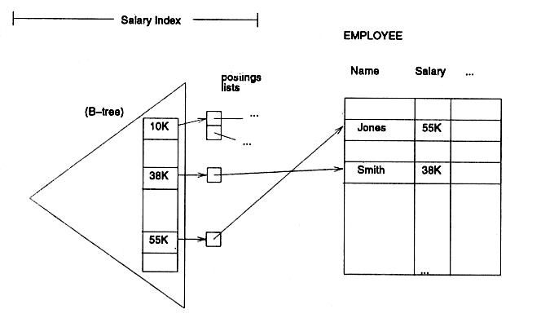
Inverted file with B-tree
E.G.M. Petrakis
Indexing

Slide 9
Grid File
Imposes a grid on the address space
  the grid adapts to the data density by introducing more divisions on areas with high data density
  grid cells correspond to disk pages
  two or more cells may share a page
  the cuts are allowed on predefined points (e.g., 1/2, 1/4, 3/4) on each axis
  M-dim. directory for M-dim. data
  directory: one entry for each cell and a pointer to a disk page
E.G.M. Petrakis
Indexing

Slide 10
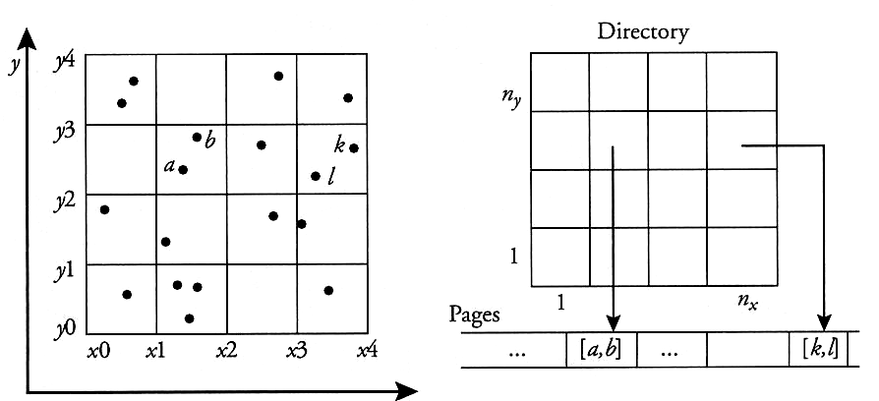
2D Grid on 2D Space
E.G.M. Petrakis
Indexing

Slide 11
Comment on Grid File
Pros:
  two disk accesses for exact match
  symmetric with respect to the attributes
  adapts to non-uniform data distributions
  good for low dimensionality spaces
Cons:
  not good for correlated attributes
  large directory for many dimensions
E.G.M. Petrakis
Indexing

Slide 12
k-d-trees
Divides the address space into disjoint regions through cuts on alternating dimensions (attributes)
  binary tree
  A different attribute as discriminator at each level
  the left sub-tree contains records with smaller values of that attribute
  the right sub-tree keeps records with greater values
E.G.M. Petrakis
Indexing

Slide 13
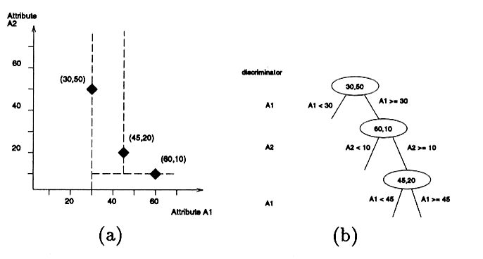
k-d-tree with 3 Records, 2 Attributes
  the divisions of the address space
  the tree
E.G.M. Petrakis
Indexing

Slide 14
Comments on k-d-tree
Pros:
  elegant and intuitive algorithms
  good performance thanks to the efficient pruning of the search space
  Good for exact, range and nearest-neighbor queries
Cons:
  main memory access method
E.G.M. Petrakis
Indexing

Slide 15
Extensions of k-d-trees
k-d-B-trees [Robinson 81]:
  divides the address space into m intervals for every node (not just 2 as the k-d-tree)
  Always balanced, disk access method
hB-tree [Lomet & Salzberg 90]:
  divides the address space into regions
  the regions may have holes
  nodes (disk pages) are organized as B-trees
  disk access method
E.G.M. Petrakis
Indexing

Slide 16
Spatial Access Methods (SAMs)
File structures that handle points, lines, rectangles, general geometric objects in high dimensional spaces
Two classes of SAMs:
  space filling curves: Z, Gray, Hilbert curves
  tree structures: R-trees and its variants
Common query types:
  point queries: find the nearest rectangles containing it
  window queries: find intersecting rectangles
E.G.M. Petrakis
Indexing

Slide 17
Space Filling Curves
Mapping of multi-dimensional space to one dimension
  visit all data points in space in some order
  this order defines an 1D sequence of points
  points which are close together in the multi-dimensional space must be assigned similar values in the 1D sequence
  A B⁺-tree for indexing
E.G.M. Petrakis
Indexing

Slide 18
Space Traversal
Visit the pixels in row-wise order
  Tends to create large gaps between neighboring points
Better ideas: Z-curves, Hilbert curves
E.G.M. Petrakis
Indexing

Slide 19
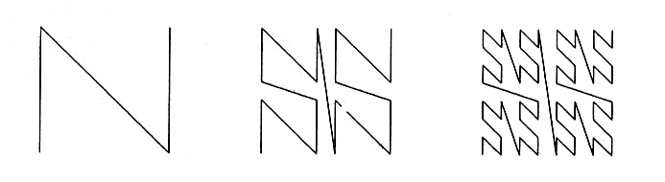
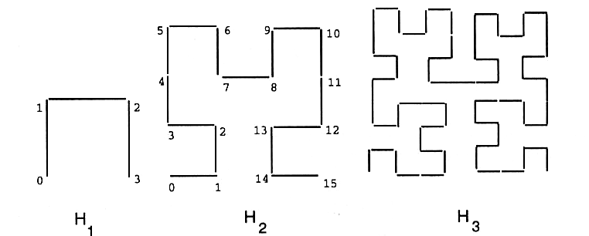
Two Common Curves
Z-curve
Hilbert
E.G.M. Petrakis
Indexing

Slide 20
Creating Indices
Bit interleaving:
  Assign k-bits per axis (2^{k} values)
  Take the x, y, … coordinates of each pixel in binary form
  Shuffle bits in some order
  Each pixel takes the value of the resulting binary number
The order with which the pixels are taken produces a mapping to 1D space
E.G.M. Petrakis
Indexing

Slide 21
Z-Order
Shuffle bits from each of the M dimensions in a round-robin fashion
  2D space: “12” take bit from x coordinate first, then bit from y coordinate
Visiting all pixels in ascending Z-value order creates a self-similar trail of N shapes
  the trail can be defined on different size grids
E.G.M. Petrakis
Indexing

Slide 22
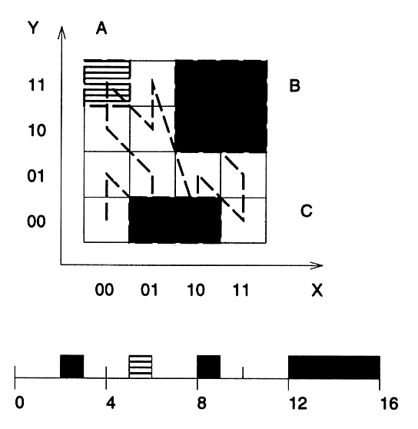
k=2 bits per pixel
Pixel A=(0,3)=(00,11): shuffle(1212,00,11)=0101=5
E.G.M. Petrakis
Indexing

Slide 23

Z Regions
A region breaks into one or more pieces each of which is described by a Z-value
  region C breaks into 2 pixels: with Z values 0010=2 and 1000=8
  region B consists of 4 pixels with common prefix 11 which is taken to be Z-value of the C region
C
B
E.G.M. Petrakis
Indexing

Slide 24
Hilbert Curve
Better clustering than Z-ordering
  Less abrupt jumps
  better distance preserving properties
E.G.M. Petrakis
Indexing

Slide 25
Tree SAMs
Quadtree: space driven access method
  good for main memory
  Linear Quadtree: combines Z-ordering with quadtrees, good for main memory and disk
R-tree: data driven access method
  good for main memory and disk
  R+-tree, R*-tree, SS-tree, SR-tree etc.
E.G.M. Petrakis
Indexing

Slide 26
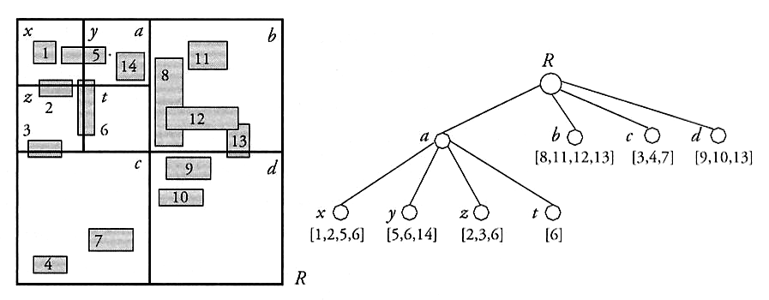
Quadtree
Recursive decomposition of space into quadrants
  decompose until a criterion is satisfied
  the index is a quaternary tree
  each node contains the rectangles it overlaps
E.G.M. Petrakis
Indexing

Slide 27
Linear Quadtree
NW 1 0 | NE 1 1
SW 0 0 | SE 0 1
Good for disk storage
  nodes: NW, NE, SW, SE
  0: S or W,
  1: N or E
  each edge has a 2-bit label (e.g., NW: 10)
  Z-value of a node: concatenate Z-values from root (e.g., shaded rectangle: 0001)
  Z-values are inserted into a B+-tree
E.G.M. Petrakis
Indexing

Slide 28
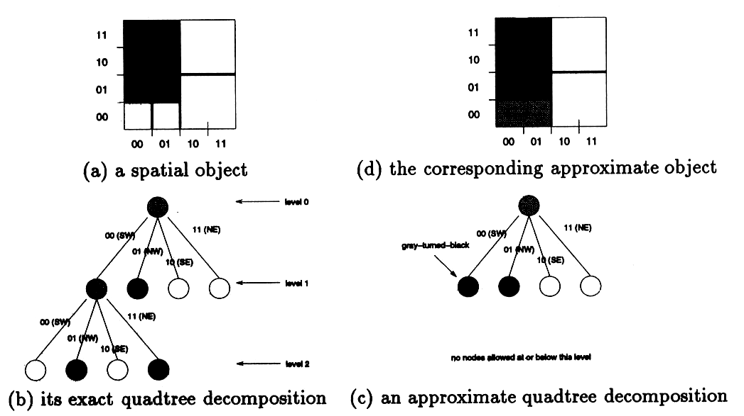
approximation contains
the shaded region
shaded rectangle: 3 blocks
E.G.M. Petrakis
Indexing

Slide 29
R-tree [Guttman 84]
The most successful SAM
Balanced, as a B+ tree for many dimensions
Objects are approximated by MBRs
Non-leaf nodes contain entries (ptr, R)
  ptr: pointer to children node
  R: MBR that covers all rectangles in child node
leaf-nodes contain entries (obj-id, R)
  obj-id: pointer to object
  R: MBR that covers all objects in child node
parent nodes are allowed to overlap
E.G.M. Petrakis
Indexing

Slide 30
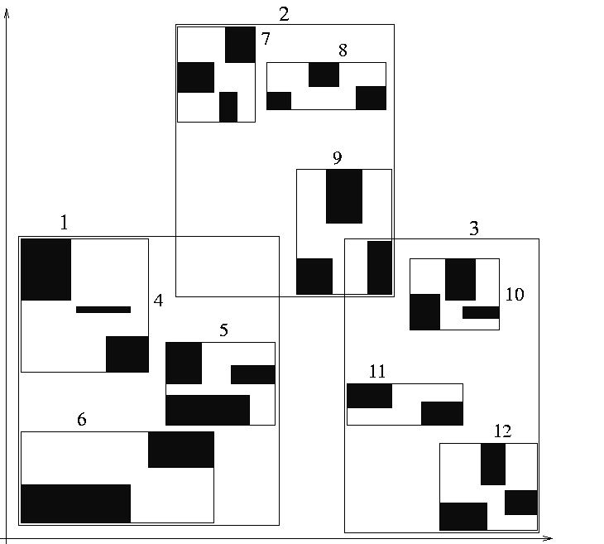
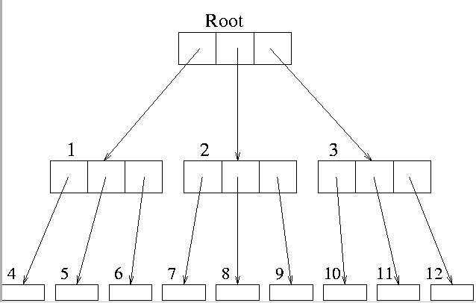
rectangles organized
as an R-tree
(fanout: 3)
R-tree leaf nodes correspond to disk pages
E.G.M. Petrakis
Indexing

Slide 31
Algorithms for R-trees
Nodes overlap leads to searching along multiple paths and recursive algorithms
Insertion: traverse tree, put in suitable node
  split if necessary
  R*-tree: differ splitting
  changes propagate upwards
  R-tree is always balanced
Range queries: traverse tree, compare query with node MBR, prune non-intersecting nodes
NN queries: more complex, branch and bound technique [Roussopoulos 95]
E.G.M. Petrakis
Indexing

Slide 32
R-trees and Variants
R*-tree: differ splits to achieve better utilization in a better structured R-tree
  when a node overflows, some of its children are deleted and reinserted
  outperforms R-tree by 30% (?)
R+-tree: nodes are not allowed to overlap
  no good space utilization, larger trees, rectangles can be duplicated, complex algorithms
  outperform R-trees for point queries: a single path is followed from the root a leaf
  R-trees outperform R+-trees for range queries
E.G.M. Petrakis
Indexing

Slide 33
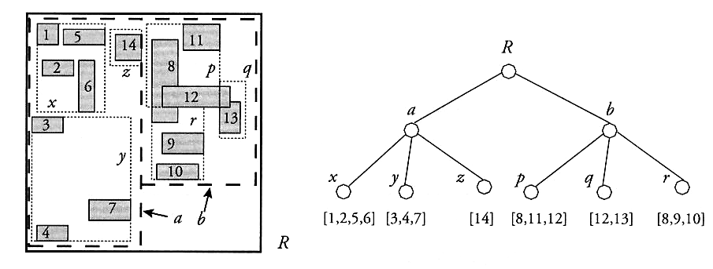
R+-tree, objects 8,12 are referenced twice
E.G.M. Petrakis
Indexing

Slide 34
Recent R-tree Variants
Different space decomposition schemes
  e.g., bounding spheres (BS) instead of rectangles
  BSs reduce overlapping of MBRs
  minimum unused space inside BSs
  BSs divide space into short-diameter regions
  BSs tend to have larger volumes than MBRs and contain more points
  less flexible: only radius varies instead of length, width
  more complex algorithms
E.G.M. Petrakis
Indexing

Slide 35
SS-tree
Similar to R*-tree
  uses spheres instead of rectangles
  good performance for point queries
SR-tree combines the structure of the R*-tree and of the SS-tree
  A bounding region is defined by the intersection of a sphere and an MBR
  good for NN-queries
E.G.M. Petrakis
Indexing

Slide 36
Metric Trees
Consider only relative distances of objects rather than their absolute positions in space for indexing
  Require that distance d is a metric
    d(a,b) = (b,a)
    d(a,b) >= 0 for a < > 0 and d(a,b) = for a = b
    d(a,c) <= d(a,b) + d(b,c)
  triangle inequality for pruning the search space
E.G.M. Petrakis
Indexing

Slide 37
VP-Tree [Yanilos 93]
Divides the space using a distance from a selected vantage point
  root: entire space (all database objects)
  left subtree: points with the less distance
  right subtree: points with greater distance
  recursive processing at each node
  a binary tree is formed
  logarithmic search time
  static, good for main memory
  m-vp-tree: multiple vantage points
E.G.M. Petrakis
Indexing

Slide 38
M-Tree [Ciaccia 97]
Combines SAMs and metric trees
Balanced tree, good for disk
Routing objects: internal nodes
Leaf nodes: actual objects
Routing objects point to covering sub-trees
Objects in a covering sub-tree are within distance r from the routing object
A routing object is associated with a distance p from its parent object
E.G.M. Petrakis
Indexing

Slide 39
Performance
Dimensionality curse: as dimensionality grows the performance drops
  even worst than sequential scanning
R-trees and variants: up to 20-30 dims for point objects, 20 dims for rectangles
  more dimensions, larger space for MBRs, fanout decreases, taller and slower tree
Fractals: good performance for 2-3 dims
M-trees: good performance for up to 10 dims
E.G.M. Petrakis
Indexing

Slide 40
References
John Louis Bentley, Jerome H. Friedman, “Data Structures for Range Searching”. Computing Surveys, Vol. 11, No 4, December 1979
Antonin Guttman, “R-trees: A Dynamic index Structure for Spatial Searching”. Proceedings ACM SIGMOD International Conference on the Management of Data, 1984.
Timos Sellis, Nick Roussopoulos and Christos Faloutsos, “The R+-Tree: A Dynamic Index for Multi-Dimensional Objects”. Proceedings of the 13th VLDB Conference, Brighton 1987.
Norbert Beckmann, Hans-Peter Kriegel, “The R*-tree: An Efficient and Robust Access Method for Points and Rectangles”. Proceedings ACM SIGMOD International Conference on the Management of Data, Atlantic City, NJ, May 1990.
David Lomet, “A Review of Recent Work on Multi-attribute Access Methods”. SIGMOD RECORD, Vol. 21, No 3,September 1992.
Peter N. Yianilos, “Data Structures and Algorithms for the Nearest Neighbor Search in General Metric Spaces”. Proceedings of the 4th Annual ACM-SIAM Symposium on Discrete Algorithms (SODA). Austin-Texas, Jan. 1993.
E.G.M. Petrakis
Indexing

Slide 41
References
Paolo Ciaccia, Marco Patella, Pavel Zezula, “M-tree: An Efficient Method for Similarity Search in Metric Space”. Proceedings of the 23rd VLDB Conference, Athens Greece, 1997.
Volker Gaede, Oliver Gunther, “Multidimensional Access Methods”. ACM Computing Surveys, Vol.30, No 2, June 1998.
Joseph M. Hellerstein, Avi Pfeffer, “The RD-tree: An Index Structure for sets”. University of Wisconsin, Computer Science Technical report 1252, November 1994.
N. Katayama and S. Satoh. The SR-tree: “An Index Structure for High-Dimensional Nearest Neighbor Queries, In Proc. of ACM SIGMOD, pages 369–380, 1997.
C. Faloutsos and S. Roseman: “Fractals for Secondary Key Retrieval”, In Proc. ACM SIGACT-SIGMOD-SIGART Symposium on Principles of Database Systems (PODS), pp. 247-252, Philadelphia, Pennsylvania, March 29-31, 1989
E.G.M. Petrakis
Indexing

